Slide 1
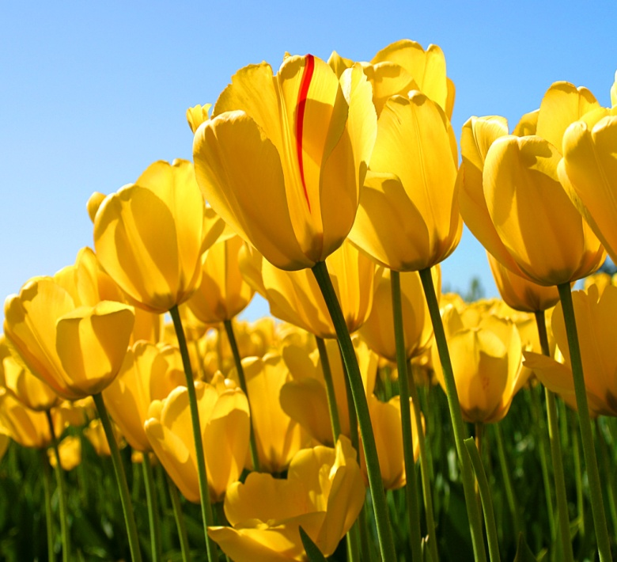
TULIPS
Notes:
One of the most beautiful flowers in the world

